Slide 1

SOLID Principles in Object-Oriented Programming
Building Maintainable and Scalable Software
Presented by: Angsar Aidarbek
Date: 17/09/2024

Slide 2
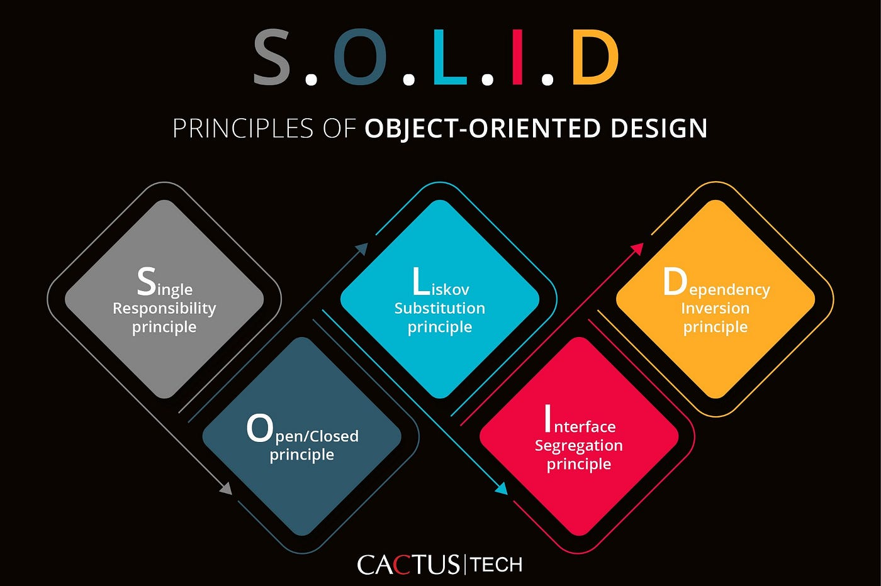
Introduction to SOLID Principles
Importance in OOP:
Reduces code complexity and dependencies.
Makes code more modular and flexible.
Encapsulates best principles for product maintaining

Slide 3

Single Responsibility Principle (SRP)
Definitions:
A class should have only one responsibility.
A class should have only one reason to change
What changes together should be kept in one place
Benefits:
Easier to maintain and refactor.
Improves code readability and testability.
Onboarding of new employees becomes easier
Testing and writing test cases is much easier
Best Practices:
Ask questions about the class/method/module/service responsibility that should be answered easily within 1-2 sentences.
Bug fixes should affect as few files/functions as possible
Minimize merge conflict problems
The information regarding the file/class functionality should be taken directly from the same file/class
Keep naming simple

Slide 4
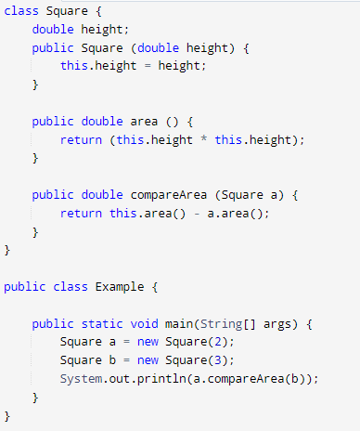
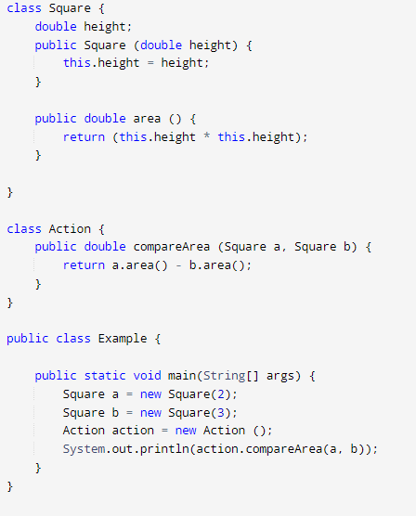
Example

Slide 5
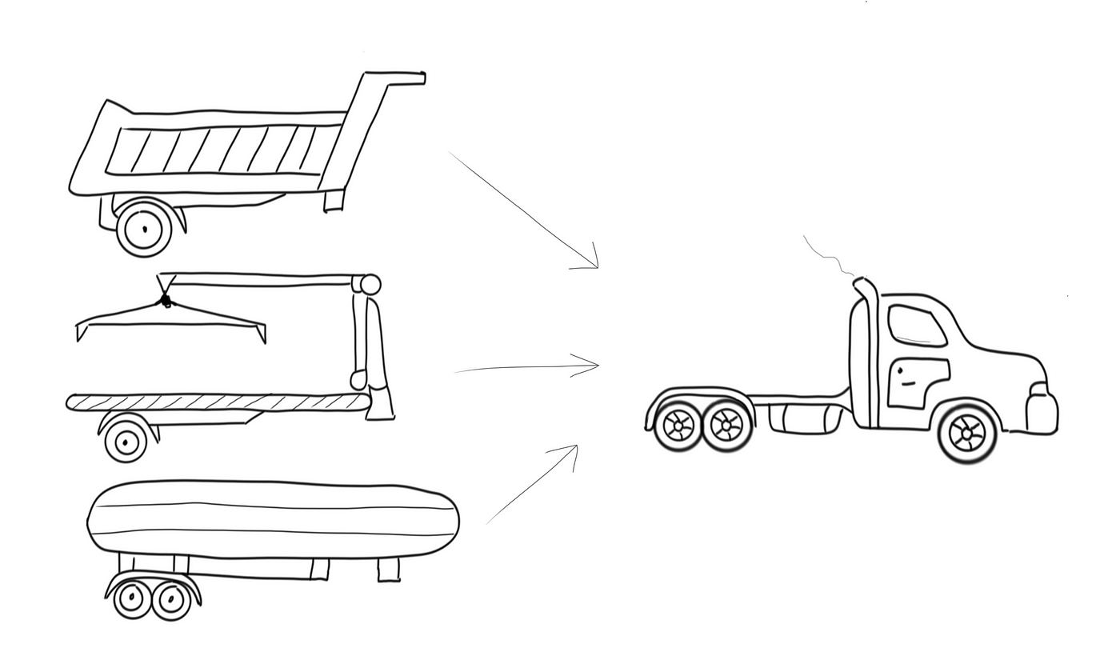
Open/Closed Principle (OCP)
Definition:
Software entities should be open for extension but closed for modification.
Takeaway:
No program can be fully closed 100%
OOP operates not with physical objects, but with concepts
Benefits:
Reduces the risk of bugs in stable code.
Facilitates adding new features without altering core logic.
Best Practices:
Close the function/class from specific changes.
Use abstraction and/or inheritance and/or interface
Use private/protected fields to reduce the amount of changes
Reduce the number of global variables ideally make it zero

Slide 6
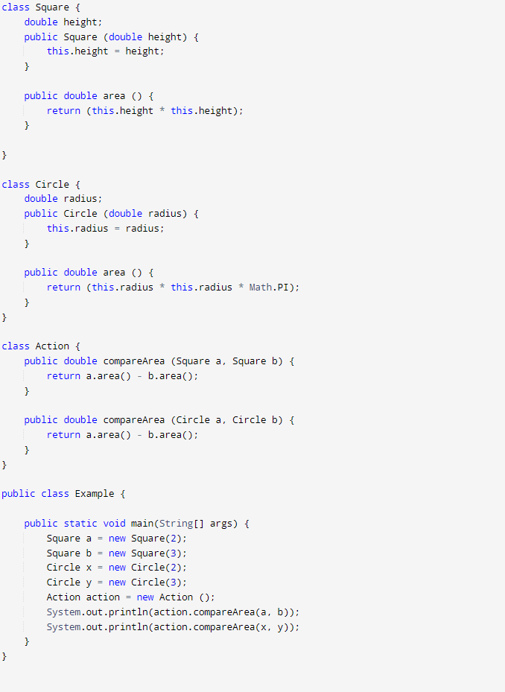
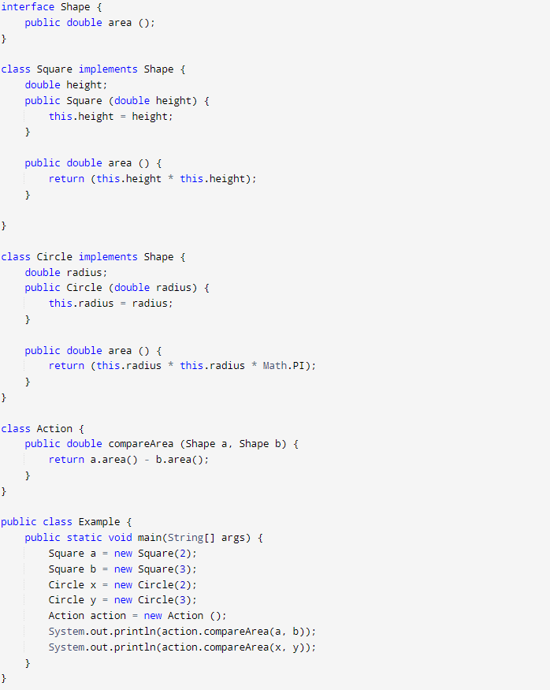
Example

Slide 7
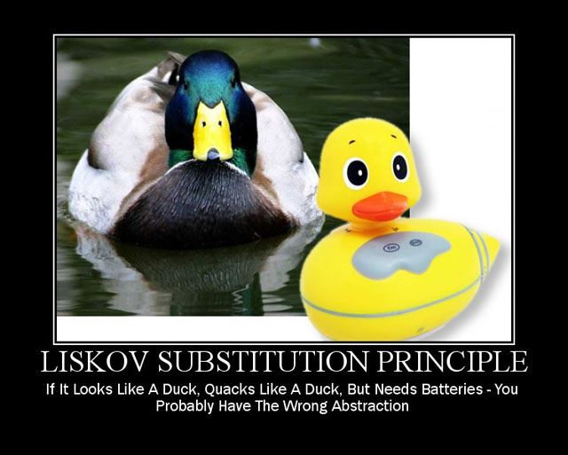
Liskov Substitution Principle (LSP)
Definition:
- Objects of a superclass should be able to be replaced with objects of a subclass without affecting the program.
Benefits:
- Enables polymorphism without breaking the behavior of the program.
Best practices:
Sub-class should have the same functions as superclass providing exactly the same output
Changing the superclass with its child, should not create problems in a complex project

Slide 8
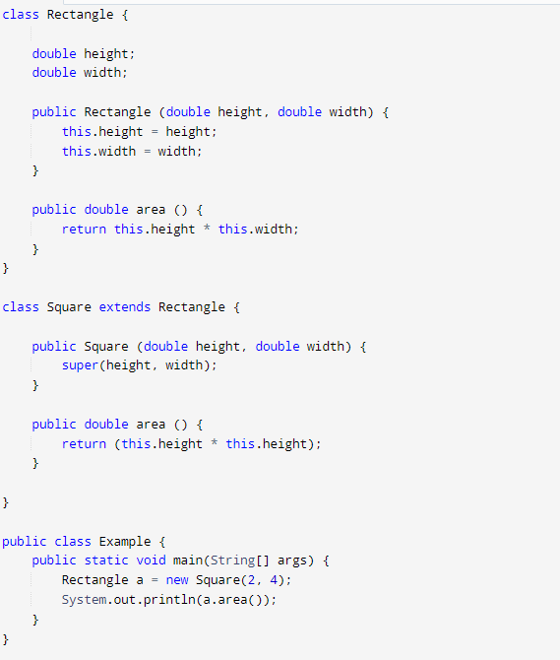
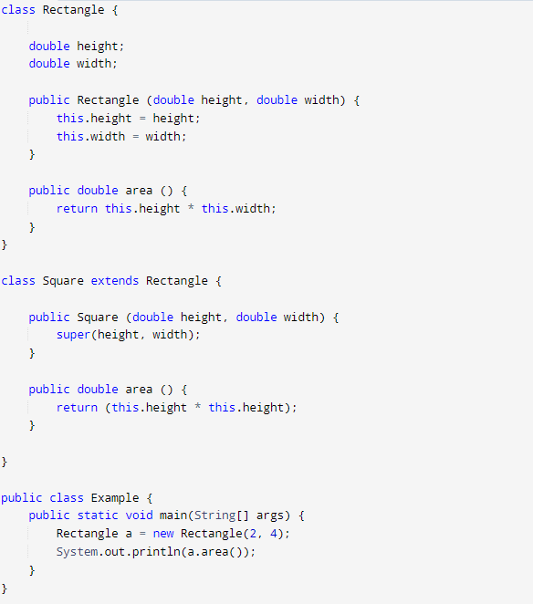
Example
Square is a rectangle
The square is a specialization of the rectangle
But making a square descendant of a rectangle will lead to strange behavior

Slide 9

Interface Segregation Principle (ISP)
Definition:
Clients should not depend on interfaces they do not use.
Benefits:
Improves flexibility and avoids fat interfaces.
Simplifies the dependencies
Best Practices:
Functions/classes should not have access to functionalities they don’t use

Slide 10
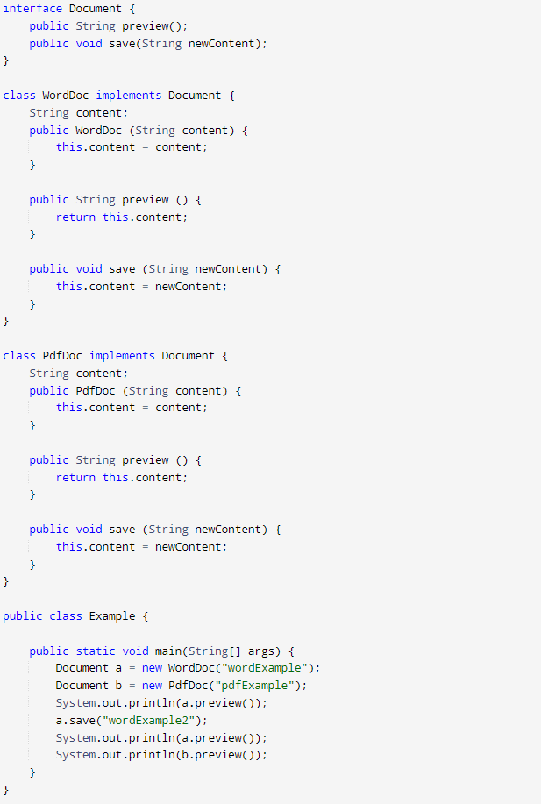
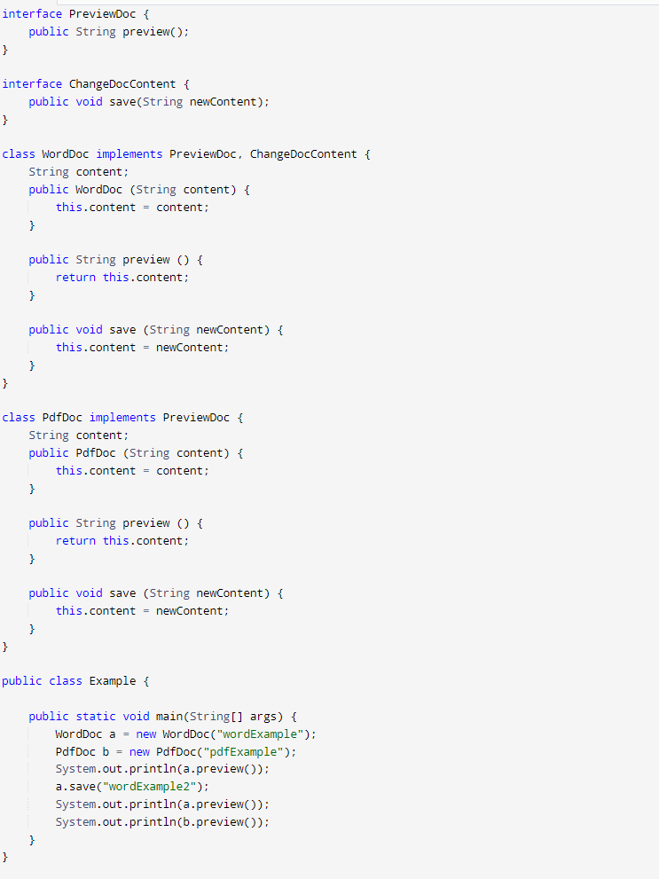
Example

Slide 11
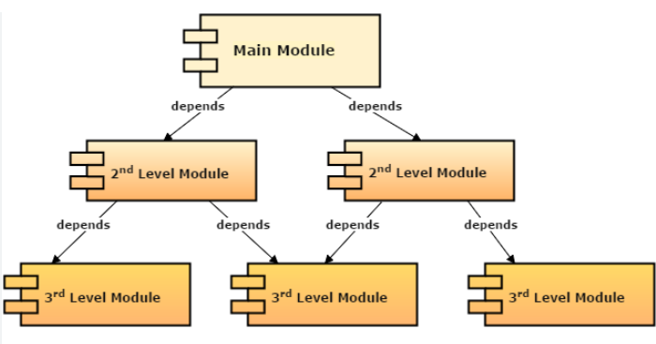
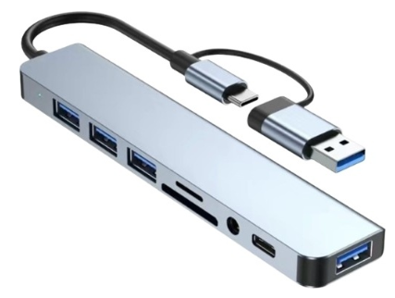
Dependency Inversion Principle (DIP)
Definition:
High-level modules should not depend on low-level modules; both should depend on abstractions.
Benefits:
Encourages decoupling and easier replacement of components.
Best Practices:
Changes in the lower module should not critically affect the higher module, should be able to fix inside a single function/class

Slide 12
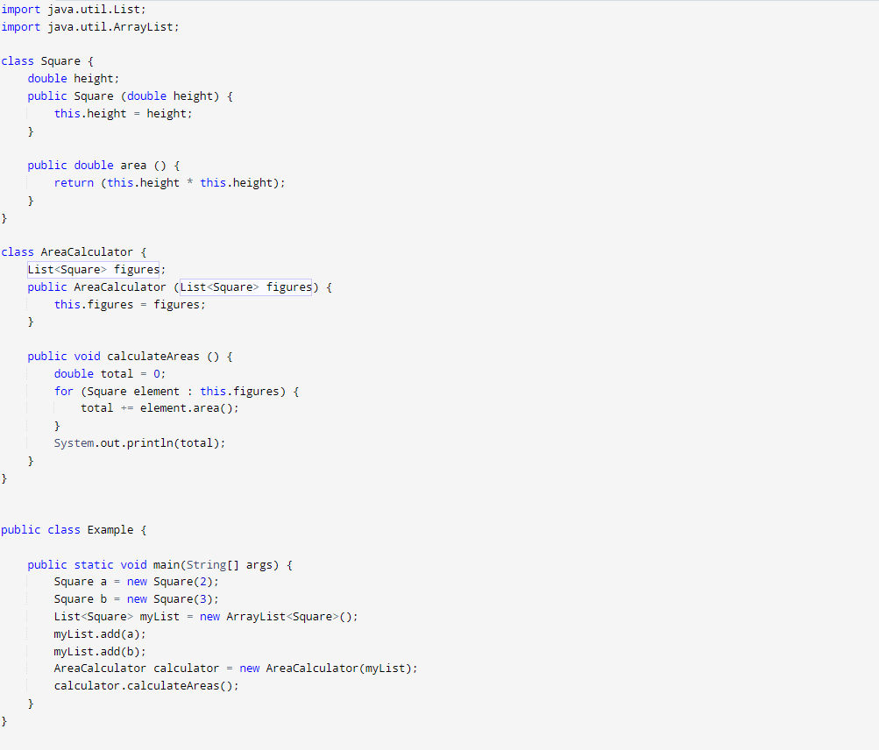
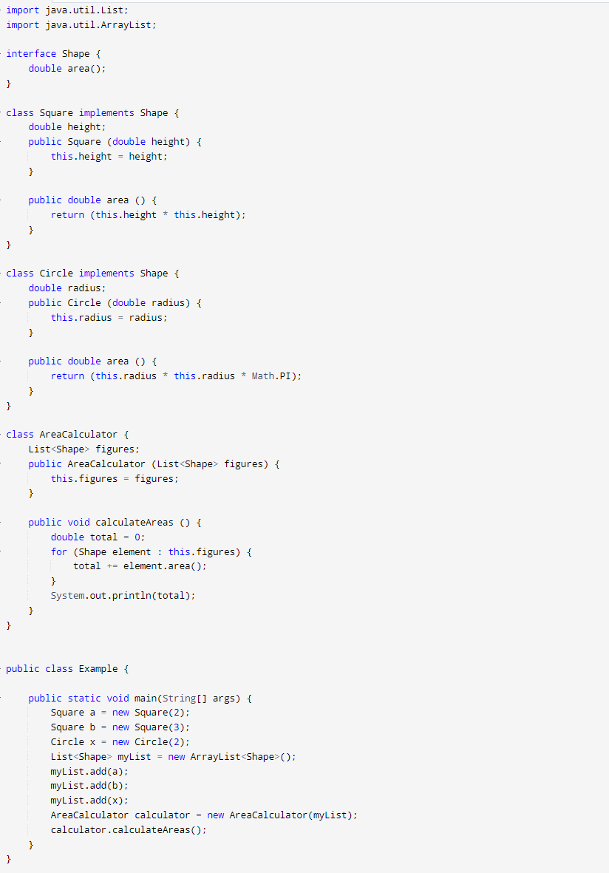
Example

Slide 13
Conclusion and Best Practices
Summary of SOLID Principles:
SRP: One class, one responsibility.
OCP: Extend without modifying core behavior.
LSP: Subtypes replace base types without breaking functionality.
ISP: Use specific, focused interfaces.
DIP: Depend on abstractions, not implementations.
Questions?

